Slide 1
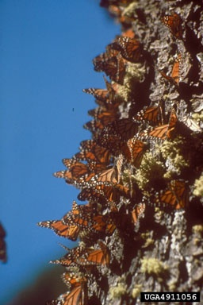

Interdependence of Life:
Populations
Growth
By Deanne Erdmann, MS
BioEd Online
Notes:
Image Reference
Yates III, H. O. Monarch butterflies. USDA Forest Service. Retrieved 4-13-2004 from www.forestryimages.org

Slide 2
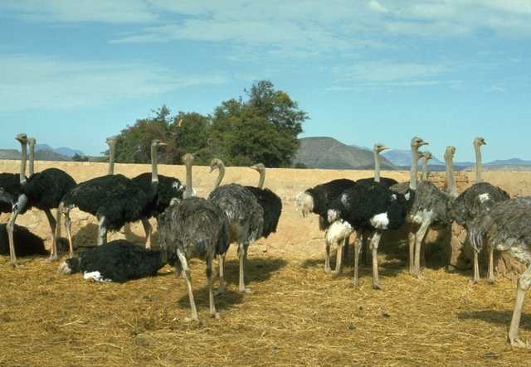

Populations
Groups of organisms of the same species that live within a given area
Key characteristics:
Dispersion patterns
Population density
Growth rate
Ostriches are nomadic, wandering in small groups.
Aspen trees are quick to pioneer areas that have been disturbed by fire.
BioEd Online
Notes:
Populations
A population is a group of individuals of the same species living within a designated area at one time. The boundary of the population may be physical—such as a mountain range—or defined by a scientist for purposes of study.
Demography is the statistical study of populations. Three important aspects of population structure are: dispersion patterns or spacing, population density, and growth rate.
References
Campbell, N.E. & Reece, J.B. (2002). Biology, (6th ed.). San Francisco: Benjamin Cummings.
Image Reference
NOVA Development Corp. (1995) Birds #2289. Art Explosion, Volume 2 Clip Art
NOVA Development Corp. (1995) New England #57. Art Explosion, Volume 2 Clip Art

Slide 3
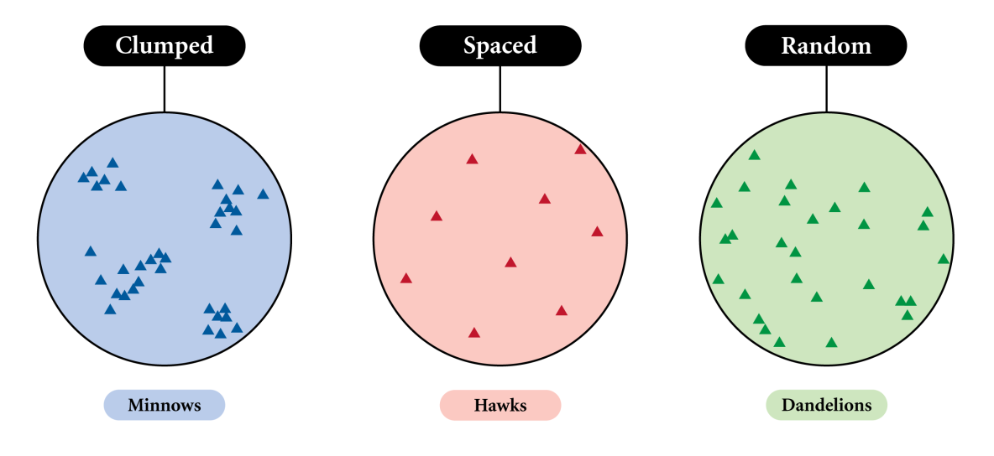
Dispersion Patterns Within Populations
Three common patterns of population distribution are:
BioEd Online
Notes:
Dispersion Patterns Within Populations
The arrangement, or dispersion, of individuals in relation to one another within a given area is one key characteristic of population study, as it reflects interactions among the population and the environment. Three patterns of population dispersion are clumped, evenly spaced, and random.
The most frequent pattern of distribution in a population is clumped. Individuals are clustered together in groups in response to uneven distribution of resources, tendency of offspring to remain with parents, or some type of social order. Clumping also may be linked with defense (safety in numbers) or mating behavior. In plants, soil type, availability of water or the manner in which the plant reproduces may favor clumped distribution patterns.
Evenly spaced distributions, in which members of the population maintain a minimum distance from one another, generally indicates strong intraspecific competition. In plant populations, this could result from competition for water, sunlight, or available nutrients, while among animals, even spacing indicates strong territoriality.
Random spacing is the least common pattern of distribution found in populations. It usually occurs because members of a species do not frequently interact with one another or are not heavily influenced by the microenvironments within their habitat.
References
Campbell, N. E. & Reece, J. B. (2002). Biology (6th ed.). San Francisco: Benjamin Cummings.
Raven, P. H. & Johnson, G. B. (2002). Biology (6th ed.). McGraw-Hill.
Image Reference
Young, M. (2004). Dispersion patterns within populations. Houston, TX: Baylor College of Medicine, Center For Educational Outreach.

Slide 4
Population Density
Population density is total population size per unit of area.
Population densities depend on:
Interactions within the environment
Quality of habitat
Density dependent factors
Density independent factors
Carrying capacity is the maximum number of organisms that can be supported in a given habitat.
Population size can be measured by several sampling techniques.
BioEd Online
Notes:
Population Density
Population density is a measure of the number of individuals of the same species living in a designated unit of space. It is influenced by relationships among organisms, movement of individuals in and out of the habitat, resources, and abiotic environmental factors (such as climate). Fluctuations in population density can be indications of changes in the environment.
Carrying capacity is the maximum number of organisms in a population that can be supported by a particular habitat. Many factors determine carrying capacity, some of which are influenced by the density of the population, while others are not. Density-dependent factors in an environment might be influenced by available food, water, and shelter. Density-independent factors include all facets of weather and climate, such as droughts, storms, and volcanic eruptions.
It often is difficult to determine the size of a population because of the wide range of the habitat or mobility of the organisms. In such cases, ecologists use a variety of sampling methods. For instance, a designated area of study might be sectioned into grids or plots. Numbers of organisms counted in selected grids are extrapolated to estimate the total population size. Mark-and-recapture is another method used to estimate population size in large geographic areas. Traps are set in the study area. Trapped organisms are tagged and released. After a period of time, traps are set again, and calculations are made based on the number of marked organisms that are recaptured.
Total population = total size of 2nd sample X marked # in 1st catch
marked # recaptured in 2nd catch
References:
Campbell, N. E. & Reece, J. B. (2002). Biology (6th ed.). San Francisco: Benjamin Cummings.
Ricklefs, R. E. & G. L. Miller. (2000). Ecology (4th ed.). New York: W.H. Freeman and Co.

Slide 5
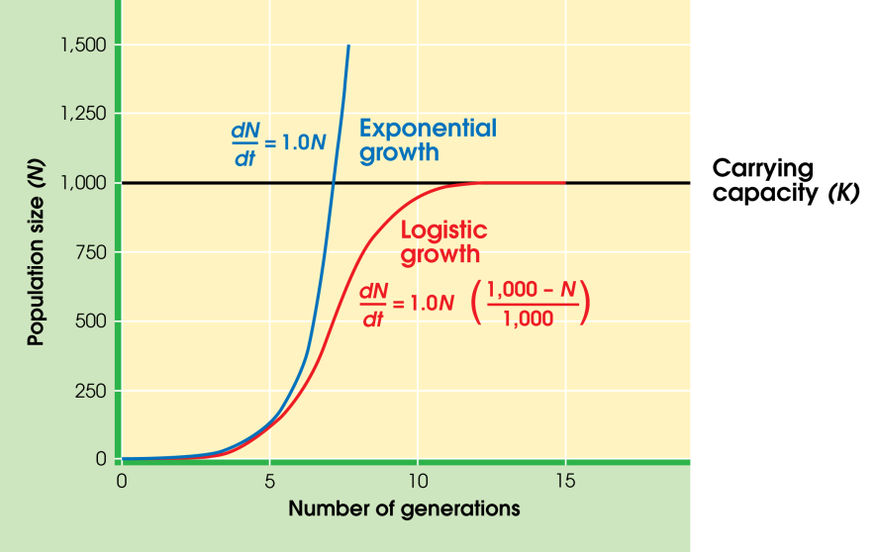
Population Growth
Exponential vs. Logistical Growth
BioEd Online
Notes:
Population Growth
Birth, death, immigration, and emigration rates factor into the growth rate of a population. Two simple models of population growth are the exponential model and the logistical model.
The growth pattern for a population with unlimited resources is exponential and represented by a “J” shaped growth curve. A population that is growing exponentially increases in a geometric pattern (for example, 2, 4, 8, 16, 32, etc.). In the formula dN/dt = r_{i}N, dN/dt is the rate of change in the number of individuals at any instant in time and r_{i} represents the innate capacity for growth of the population (biotic potential) when in an unlimited environment. Populations that are introduced to a new environment or are recovering from a catastrophic event (such as a fire) usually exhibit “J” shaped growth curves.
Population growth eventually reaches a limit imposed by factors such as light, space, nutrients, or water. Carrying capacity (K) is the maximum number of individuals a particular habitat can support. Growth in a logistical model slows as it approaches the carrying capacity of the environment and forms an “S” shaped growth curve. In reality, populations sometimes will overshoot K, followed by a rapid decline, until conditions for growth are restored.
References
Campbell, N. E. & Reece, J. B. (2002). Biology (6th ed.). San Francisco: Benjamin Cummings.
Raven, P. H. & Johnson, G. B. (2002). Biology (6th ed.). McGraw-Hill.
Image Reference
Young, M. (2004). Exponential vs. logistical growth graph. Houston, TX: Baylor College of Medicine, Center For Educational Outreach.

Slide 6
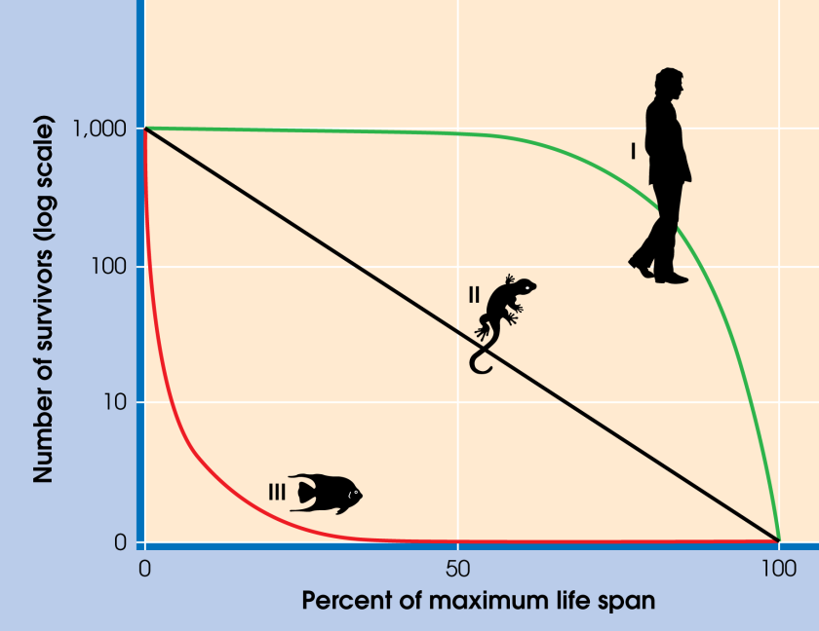
Survivorship in Populations
BioEd Online
Notes:
Survivorship in Populations
Survivorship curves are graphic representations of the age structure of a given population. They are used to predict the future growth of the population. Type I curves reflect relatively low death rates early in life and through midlife, with a sharp increase in death rate among older-age groups (e.g., humans). Type II curves illustrate a fairly even mortality rate throughout the life span of the organism (e.g., birds). Populations with high death rates early in life followed by a sharp decline of death rates for the survivors are represented by Type III survivorship curves (e.g., fish and many insect populations).
References
Campbell, N. E. & Reece, J. B. (2002). Biology (6th ed.). San Francisco: Benjamin Cummings.
Ricklefs, R. E. & G. L. Miller. (2000). Ecology (4th ed.). New York: W.H. Freeman and Co.
Image Reference
Young, M. (2004). Survivorship graph. Houston, TX: Baylor College of Medicine, Center For Educational Outreach.

Slide 7
Reproductive Strategies
r- Selected (maximum growth rate, below carrying capacity)
Early reproduction
Short life span
High mortality rate
Little or no parental care
Large investment in producing large numbers of offspring
Below carrying capacity
Examples:
Bony fish
Grasshoppers
K-Selected (maximizes population size near carrying capacity)
Late reproduction
Long life span
Low mortality rate
Extensive parental care
Greater investment in maintenance and survival of adults
At or near carrying capacity
Examples:
Sharks
Elephants
BioEd Online
Notes:
Reproductive Strategies
In an uncrowded environment, such as a recently abandoned crop field, natural selection pressure tends to favor populations that invest heavily in offspring, have shorter life spans, capacity for widespread dispersion, and usually provide little or no parental care for offspring (for example, mosquitoes, ragweed, or mice). These populations tend to increase exponentially and often are referred to as r-strategist, where r refers to the intrinsic rate of growth of the population. In contrast, crowed conditions favor organisms with lower rates of population growth, but improved capabilities to utilize and compete for resources. These populations maintain themselves at levels close to carrying capacity (K) and are referred to as K-strategist.
Biologist refer to the types of selection pressure placed on populations as r-selection, if individuals that reproduce rapidly and abundantly are favored, and as K-selection, if individuals that compete well in crowded conditions are favored over time.
References
Campbell, N. E. & Reece, J. B. (2002). Biology (6th ed.). San Francisco: Benjamin Cummings.
Odum, E. (1997). Ecology: A Bridge Between Science and Society. Sunderland, MA: Sinauer Associates, Inc.
Raven, P. H. & Johnson, G. B. (2002). Biology (6th ed.). McGraw-Hill.

Slide 8
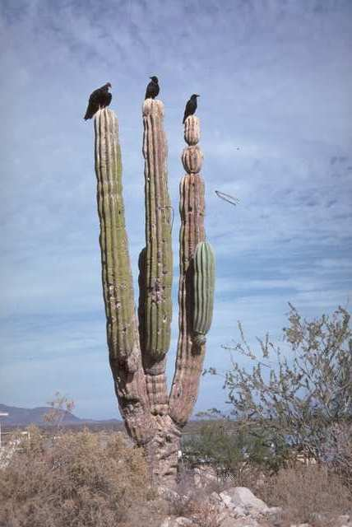

Limits on Population Growth
Density Dependent Limits
Food
Water
Shelter
Disease
Density Independent Limits
Weather
Climate
Water and shelter are
critical limiting factors in
the desert.
Fire is an example of a
Density independent
Limiting factor.
BioEd Online
Notes:
Limits on Population Growth
Carrying capacity (K) is the maximum number of organisms of a population that can be supported by a particular habitat. As population numbers approach the carrying capacity of an environment, in other words as density increases, competition for resources is amplified. Density-dependent factors in an environment include available food, nutrients in the soil, water, and shelter, among many others. The buildup of metabolic wastes also increases with density and adversely affects many populations as well.
Weather, climate, and human activities can be density-independent factors which affect the environment. In the case of catastrophic events or the pressure of toxins, populations are affected regardless of size. Populations recover at different rates, some even experiencing a permanent decline after a major change in the environment.
References
Campbell, N. E. & Reece, J. B. (2002). Biology (6th ed.). San Francisco: Benjamin Cummings.
Raven, P. H. & Johnson, G. B. (2002). Biology (6th ed.). McGraw-Hill.
Image Reference
NOVA Development Corp. (1995) Birds #2516. Art Explosion, Volume 2 Clip Art
NOVA Development Corp. (1995) Wilderness #319. Art Explosion, Volume 2 Clip Art

Slide 9
Thank You
This concludes a brief review of ecological populations.
You may find additional information on this section in the expanded content talks, and in the notes attached to each slide in the slide library.
BioEd Online

